Slide 1
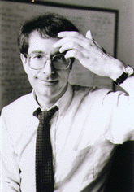
“I want my children to understand the world, but not just because the world is fascinating and the human mind is curious. I want them to understand it so that they will be positioned to make it a better place. Knowledge is not the same as morality, but we need to understand if we are and what we can do…..Ultimately, we must synthesize our understandings for ourselves. The performance of understanding that try matters are the ones we carry out as human beings in an imperfect world which we can affect for good or for ill.” -Howard Gardner 1999: 180-181
Howard Gardner – Multiple Intelligences
http://www.indiana.edu/~intell/gardner.shtml

Slide 2
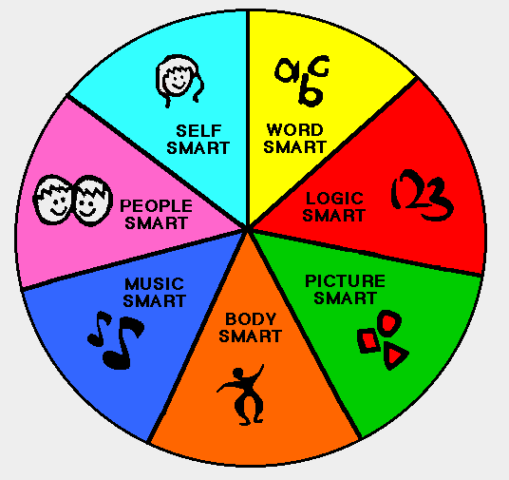
Howards Theory of Multiple Intelligences
Self Smart = Intrapersonal
Word Smart = Linguistic
Logic Smart = Logical/Mathematical
Picture Smart = Visual/Spatial
Body Smart = Bodily/Kinesthetic
Music Smart = Musical
People Smart = Interpersonal
http://www.fafutoys.com/blog/2010/04/28/multiple-intelligence-how-many-do-you-have/

Slide 3
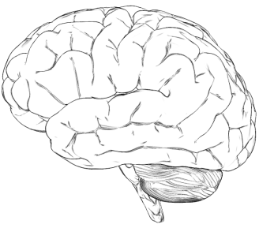
Frames of Mind : The Theory of Multiple Intelligences
*Gardner said that multiple intelligences were not limited *
http://mset.rst2.edu/portfolios/t/thoman_j/toolsvis/mapplerproject/brain.html
Intelligence type | Capability and perception
Linguistic | words and language
Logical-Mathematical | logic and numbers
Musical | music, sound, rhythm
Bodily-Kinesthetic | body movement control
Spatial-Visual | images and space
Interpersonal | other people's feelings
Intrapersonal | self-awareness
Intelligence type | Capability and perception
Naturalist | natural environment
Spiritual/Existential | religion and 'ultimate issues'
Moral | ethics, humanity, value of life
N
E
W
http://www.businessballs.com/howardgardnermultipleintelligences.htm

Slide 4
Applying Gardner's Theory
Classroom
Logical- Mathematical Intelligence
Hands-on problem solving
Verbal Intelligence
Verbally explaining a lesson to the classroom
Musical Intelligence
Writing a song to explain a concept or review a subject
Interpersonal Intelligence
Study groups
Linguistic Intelligence
Discussions of information – book talks
Bodily-Kinesthetic
Performing a dance with movements that explain a story
Intrapersonal Intelligence
Taking time to write flash cards for self review

Slide 5
Applying Gardner's Theory
Parenting
Interpersonal Intelligence
To put yourself in someone else's shoes and understand why they are behaving a certain way
Talk about how families act
Verbal Intelligence
You can help explain things to your child, have them explain things to you
Your examples – Name an Intelligence and give a sample activity

Slide 6
What intelligence applies to you the most?
What intelligence do you prefer the most?
Why?

Slide 7
How can you use the types of intelligences to help you understand information better?

Slide 8
Final Summation:
Multiple intelligences
-Musical, spatial, kinesthetic, interpersonal, intrapersonal, naturalist, linguistic, and logical abilities
Purpose for education: help understand various ways
-Physical, biological, social, personal
Subject multiple entry points
-Affecting a topic in many ways
-Each point hits one or more of the multiple intelligences
Narrative points: stories
Numerical points: math
Aesthetic points: music/art
Hands on activities: kinesthetic
Debate and role play: linguistic
Exhibitions and projects
- Show what they learned
- Reflect knowledge and skills
- Multiple intelligences used
Focus on limited number of topics, but explore them deeply and in many different ways

Slide 9
Bibliography
Elibrary. N.p., n.d. Web. 14 Sept. 2011. <http://elibrary.bigchalk.com/elibweb/curriculum/do/document?set=search&dictionaryClick=&secondaryNav=&groupid=1&requestid=lib_standard&resultid=2&edition=&ts=30FF4C174B49314E5714B71994D6306B_1316009081832&start=1&publicationId=&urn=urn%3Abigchalk%3AUS%3BBCLib%3Bdocument%3B78423798>
Elibrary. N.p., n.d. Web. 14 Sept. 2011. <http://elibrary.bigchalk.com/elibweb/curriculum/do/document?set=search&dictionaryClick=&secondaryNav=&groupid=1&requestid=lib_standard&resultid=4&edition=&ts=30FF4C174B49314E5714B71994D6306B_1316009081832&start=1&publicationId=&urn=urn%3Abigchalk%3AUS%3BBCLib%3Bdocument%3B74908534>.
Multiple Intelligence. N.p., n.d. Web. 14 Sept. 2011. <http://www.businessballs.com/howardgardnermultipleintelligences.htm>.

